Slide 1

Tutorial on IQM Tools Pro
Linking Systems Pharmacology Models to Clinical Data
Integrated Solutions for Quantitative Drug Development
From Mechanistic Models to Complex Trial Simulation
Henning Schmidt, IntiQuan GmbH
6

Slide 2
Tutorial Outline
General introduction to the IQM Tools Suite
Compliance mode
Models: dosing, output and parameter definitions
  Define dosing inputs
  Define observation outputs
  Define parameters to estimate and to use as regression parameters
Dosing description and simulation
  Definition of dosing schemes
  Simulation of dosing schemes

Slide 3
Tutorial Outline
Import and export of SBML models
  General import / export
  Handling cases where SBML models are incompletely defined
  Handling cases where SBML IDs are randomly generated (e.g. Simbiology, CellDesigner)
Important things to consider for systems pharmacology models
  Bad examples
  Suggestions for good modeling practice
    Model features to avoid in order to allow use of standard NLME parameter estimation tools
    Steady-state implementation
    Clear input and output definitions

Slide 4
Tutorial Outline
Interface to NLME Tools
  Conversion of IQMmodels to NONMEM and MONOLIX
  Running NONMEM and MONOLIX from IQM Tools
  Fitanalysis results – overview
  Robustness analysis
General representation of clinical data
  Generalized data format for clinical data used in IQM Tools
  Checking of data consistency
  Conversion to task specific dataset format
  Graphical exploration
  Conversion to dataset for nonlinear mixed effect parameter estimation
Examples

Slide 5
Tutorial Info
In large parts you will have the opportunity to get hands-on-experience
>> installIQMtoolsInitial
Commands shown in these boxes should be entered on the MATLAB
command line, during the tutorial
********** MODEL NAME
Simple model
********** MODEL STATES
d/dt(Ad)= -ka*Ad + INPUT1
d/dt(Ac)= ka*Ad – CL/Vc*Ac
********** MODEL PARAMETERS
ka = 0.2
CL = 0.3
Vc = 6
********** MODEL VARIABLES
Cc = Ac/Vc
Text shown in these boxes should
be entered where appropriate
(will become clear later)

Slide 6
Tutorial Goal: „You should be able to“
Understand and use the compliance mode – or switch it off
Define IQMmodels with dosing inputs and simulate dosing scenarios
Import models from SBML to IQMmodels, add inputs and outputs for simulation and NLME approaches
Understand the requirements on model definition for use of NONMEM or MONOLIX as parameter estimation tools
Convert models to NONMEM and MONOLIX and estimate parameters
Understand and handle the general dataset specification

Slide 7
Tutorial Outline
General introduction to the IQM Tools Suite
Compliance mode
Models: dosing, output and parameter definitions
Dosing description and simulation
Import and export of SBML models
Important things to consider for systems pharmacology models
Interface to NLME Tools
General representation of clinical data
Examples

Slide 8
Introduction to the “IQM Tools Suite”
The IQM Tools Suite is provided freely and as open source
The IQM Tools Suite consists of two main packages
  IQM Tools Lite
  IQM Tools Pro
The whole is based on MATLAB (www.mathworks.com)
IQM Tools Lite
Model, experiment, measurement & dosing representation, simulation, analysis functions, optimization, signal processing, statistical functions, etc.
IQM Tools Pro
Systems biology/pharmacology and PMX functionality, clinical data analysis, nonlinear mixed effect modeling, clinical trial simulations, high speed simulation through transparent C-code interface

Slide 9
Modular Design of the IQM Tools Suite
MONOLIX
NONMEM
IQM Tools Pro (pmx) (population PKPD, workflows, trial simulation, ...)
IQM Tools Pro
(sys)
(parameter
determination
functionality)
GUI Functions
(Model editing, visualization, etc.)
IQM Tools Lite
Functions
(Analysis, Simulation, etc.)
Optimization
Algorithms
SUNDIALS
CVODES
Powerful
Solvers
Low-Level Functions
(creating, converting objects)
Signal Processing
functions
Statistical
functions
IQMprojectSB
IQMmodel / IQMmeasurement
IQMexperiment/IQMdosing
SBML
Toolbox
MEX
MATLAB
ODE FILE
..., ..., ...

Slide 10
Requirements
MATLAB R2013b (or later)
  Optional but very useful: Parallel Toolbox to allow for better runtimes of the examples
Required 3rd party software
  SBML Toolbox (included in IQM Tools for Windows)
  Monolix Version 4.2.3 (or later) (http://www.lixoft.org)
  NONMEM Version 7.2 (or later) (http://www.iconplc.com)

Slide 11

Where to get IQM Tool Suite from?
Free download of IQM Tools Suite available from the IntiQuan webpage
The IQM Tools Suite is distributed as a ZIP file with both IQM Tools Lite and IQM Tools Pro included
Unzip this ZIP file on your computer at a location where you want to store the IQM Tools
www.intiquan.com

Slide 12
How to Install the IQM Tool Suite?
Start MATLAB
Change into the “IQM Tools Suite” folder
Read and update custom information in setup files:
  IQMlite/SETUP_PATHS_TOOLS_IQMLITE.m
  IQMpro/SETUP_PATHS_TOOLS_IQMPRO.m
Execute the “installIQMtoolsInitial” script
You need to execute the “installIQMtoolsInitial” script once after obtaining a copy of IQM Tools. This will compile required libraries.
After this first installation, you can use the function “installIQMtools” to install IQM tools. This needs to be done each time you exit and start MATLAB again. This is on purpose for compliance and reproducibility reasons.
If you do not care about compliance, you might want to consider the use of a startup.m script (see http://www.mathworks.com/help/matlab/ref/startup.html).

Slide 13
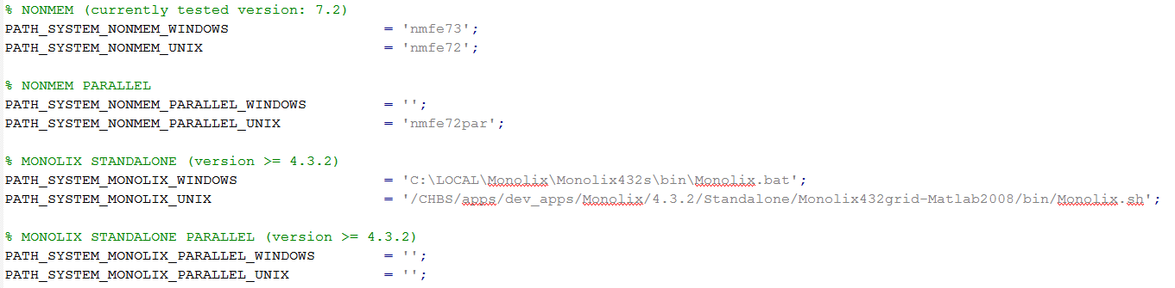
Installation of 3rd party software
Please follow the providers instructions when installing optional 3rd party software.
  Update the IQMpro/SETUP_PATHS_TOOLS_IQMPRO.m file with the relevant information, as shown below for an example implementation

Slide 14
IQM Tools’ Documentation
  MATLAB style help
IQM Tools Tutorials with examples
  Part 1: IQM Tools Lite (General Model Specification, Simulation, etc.)
  Part 2: IQM Tools Pro (MEX / Systems Biology/Pharmacology Projects)
  Part 3: IQM Tools Pro (Basic Pharmacometrics)
  Part 4: IQM Tools Pro (General Dataset Specification and PMX Workflows)
  Part 5: IQM Tools Pro (Advanced Clinical Trial Simulations)
  Part 6: IQM Tools Pro (Linking Systems Pharmacology Models to Clinical Data)
  IQM Tools – Workshops
    Given on demand and on some conferences during a year
>> help IQMlite
>> help IQMpro
>> help IQMsimulate
>> help IQMexportCSVdataset
>> doc IQMlite
>> doc IQMsimulate

Slide 15
Tutorial Outline
General introduction to the IQM Tools Suite
Compliance mode
Models: dosing, output and parameter definitions
Dosing description and simulation
Import and export of SBML models
Important things to consider for systems pharmacology models
Interface to NLME Tools
General representation of clinical data
Examples

Slide 16
Compliance Mode
The Pharma World is highly regulated. For every modeler it is important to ensure that the complete modeling project (models, scripts, data, outputs) are well documented and all results are easily reproducible
IQM Tools allows to annotate each produced figure and each produced table or text file by the username of the modeler, date and time, and the names of the scripts that were run to produce the output
  This is accomplished by generating a .log file for each output (figure and text / table file)
  The IQM Tools Reporting package will link this log information with the table or figure in the generated report
  This feature is called „Compliance Mode“
  The Compliance Mode can be turned on or off in the IQMlite/SETUP_PATHS_TOOLS_IQMLITE.m setup file. When using IQM Tools for work on clinical projects, it should always be turned on.
IQM Tools additionally allows a very structured approach to coding / organization of models, scripts, output, data that allows reproducibility of results by any person

Slide 17

Setup the Compliance Mode
Change into the IQMlite folder
Switch on the Compliance Mode by setting the corresponding variable to 1
Or switch it off by setting the value to 0
The log files are created when figures and text files are generated by the following IQM Tools commands:
  IQMprintFigure
  IQMwriteText2File

Slide 18

Example for Compliance Mode
Change into the „Example Files“ folder
„testscript.m“ is a template analysis script that as first step clears the workspace and installs IQM Tools and in a second step initializes the compliance mode
>> IQMnewscript('testscript') % Creates a template analysis script
>> edit testscript.m

Slide 19
Example for Compliance Mode
Add the following text into the testscript.m
Execute the whole script by pressing „F5“
=> Output files and associated .log files are created
%% Here your code starts
% Write example text to text file
text = 'Hello World!';
IQMwriteText2File(text,'textfile.txt')
% Write example figure to PNG file
t = [0:1:100];
plot(t,sin(0.1*t));
IQMprintFigure(gcf,'figurefile','png')
>> edit textfile.txt.log
>> edit figurefile.png.log

Slide 20

Example for Compliance Mode
Comment out the IQMinitializeCompliance call
Rerun the script by pressing „F5“
An error appears, since the compliance mode is set to on but no call to IQMintializeCompliance has been done after the last „clear all“
Edit the argument to the IQMinitializeCompliance call and rerun by „F5“
The name of the script and the input argument to IQMinitializeCompliance need to match

Slide 21
Additional Compliance / Reproducibility Considerations
Typical pharmacometric modeling and analysis code is „messy“ and very difficult to audit
IQM Tools allows a good organization of scripts, models, data, and outputs that is easy to understand
  In the workflow tools IQM Tools imposes such a structure
  In free modeling activities it is suggested that the modeler uses the following structure
    Root folder
      „Scripts“: Containing analysis scripts with numeric ordering, e.g.:
        SCRIPT_01_data_preparation
        SCRIPT_02_popPK
      „Data“: The datasets
      „Models“: The generated IQMmodels or NLME models
      „Output“: The generated output (figures, tables, etc.)
This structure will be used in the following examples (where applicable)

Slide 22
Tutorial Outline
General introduction to the IQM Tools Suite
Compliance mode
Models: dosing, output and parameter definitions
  Define dosing inputs
  Define observation outputs
  Define parameters to estimate and to use as regression parameters
Dosing description and simulation
Import and export of SBML models
Important things to consider for systems pharmacology models
Interface to NLME Tools
General representation of clinical data
Examples

Slide 23
IQMmodel syntax linking the model to dosing inputs and observations in clinical data (for parameter estimation)
Same syntax as for IQMmodels
  ODEs or biochemical representation can be used
Additional elements
  INPUT*: Allows to define dosing inputs – linking to doses in datasets
  OUTPUT*: Allows to define outputs – linking to clinical observations in datasets
********** MODEL NAME
Linear two compartmental distribution PK model
********** MODEL STATES
d/dt(Ac) = -CL/Vc*Ac – Q/Vc*Ac + Q/Vp*Ap + INPUT1
d/dt(Ap) = + Q/Vc*Ac - Q/Vp*Ap
********** MODEL PARAMETERS
CL = 20 % (L/hour) Clearance
Vc = 32 % (L) Central volume
Q = 12 % (L/hour) Intercompartmental clearance
Vp = 1450 % (L) Peripheral volume
********** MODEL VARIABLES
Cc = Ac/Vc % Calculation of plasma concentration
OUTPUT1 = Cc
Example model

Slide 24
IQMmodel Syntax - INPUTs
INPUT Definitions in IQMmodels
  Please open the example file inputExamples.m in the folder
  Example Files/MODEL_SYNTAX and work it through
  Example for a single input definition in an ODE based model (model1.txt)
  Example for a single input definition in an model based on biochemical reaction equations (model2.txtbc)
  Both models above are mathematically identical.
  The inputExamples.m file contains also a more complex input example
********** MODEL STATES
d/dt(Ac) = -VMAX*Cc/(KM+Cc) + F*INPUT1
********** MODEL REACTIONS
=> Ac : v_input
vf = F*INPUT1
Ac => : v_clearance
vf = VMAX*Cc/(KM+Cc)

Slide 25
IQMmodel Syntax - INPUTs
A model can contain arbitrarily many input definitions
INPUT* where "*": 1,2,3,4,5. Indices do not need to be sequential and do not need to start at 1, but they need to be numeric
Input definitions are only allowed in differential equations and in reactions
In the latter case the reaction name in the ODE is replaced by the reaction expression to have the input definition in the ODE
A prefactor is allowed, e.g. 1.5*INPUT1 or (k1+k2)*INPUT2 or F*INPUT4 No postfactors are allowed. A "*" character has to stand between prefactor and INPUT* definition
Input terms (INPUT* identifier and prefactor) are only allowed to be added (+) to the differential equation. But they can be the first term in the ODE, not requiring a leading "+" sign
If a parameter with the name "INPUT*" is defined in the model, its value will not be changed during import. If the model does not contain an INPUT* parameter, it is added and set by default to "0". INPUT* is only allowed to be defined as a parameter. Not as a variable and not as a reaction
Only parameters (and numerical values) are allowed to be used in the definition of INPUT* prefactors. But no states, variables and reactions
INPUT* definitions are not allowed to be enclosed in any parentheses

Slide 26
IQMmodel Syntax - OUTPUTs
OUTPUT Definitions in IQMmodels
  Please open the example file inputExamples.m in the folder
  Example Files/MODEL_SYNTAX and work it through
  Example for a single output definition in an IQMmodel (model1.txt and model2.txtbc)
The reason for the availability of these OUTPUT* definitions is that IQMtools uses these when interfacing IQM Tools with pharmacometric parameter estimation tools (NONMEM and MONOLIX)
The right hand side of OUTPUT* definitions should NOT contain mathematical expressions, but only get assigned previously defined variables (in this example: Cc)
********** MODEL VARIABLES
Cc = Ac/Vc % (ng/ml) Plasma concentration
OUTPUT1 = Cc % (ng/ml) Output variable

Slide 27
IQMmodel Syntax - OUTPUTs
OUTPUT* where "*": 1,2,3,4,5, ... In contrast to INPUT* definitions, the OUTPUT indices NEED TO BE sequential, starting from 1. No number is allowed to be excluded
Output definitions are only allowed to appear in the model variables section
The right hand side of OUTPUT* definitions should NOT contain mathematical expressions, but only get assigned previously defined variables
OUTPUT* variables are NOT allowed to depend on INPUT* components

Slide 28
IQMmodel Syntax – Parameter Info
The last elements of the IQMmodel syntax are flags that indicate if a certain parameter should be estimated or obtained from a dataset (called: regression parameter)
This is done by adding in
the comment section of a
parameter the reserved
words <estimate> or
<regression>
If a parameter is neither
estimated nor provided as
regression parameter, its
value will be kept on the
value defined in the model
itself
Example Files/Model_Syntax/model_estimation.txt
********** MODEL PARAMETERS
% PK parameters obtained from dataset
F_subcut = 0.5 % <regression> (.)
CL = 0.303 % <regression> (L/day)
Vc = 2.83 % <regression> (L)
Q = 0.724 % <regression> (L/day)
Vp = 4.43 % <regression> (L)
VMX = 0.5 % <regression> (mg/day)
KM = 1.86 % <regression> (ug/ml)
% PD parameters to be estimated
BASELINE = 1 % (.)
kdeg = 0.1 % <estimate> (1/day)
EMAX = 1 % <estimate> (.)
EC50 = 1 % <estimate> (ug/ml)

Slide 29
Tutorial Outline
General introduction to the IQM Tools Suite
Compliance mode
Models: dosing, output and parameter definitions
Dosing description and simulation
  Definition of dosing schemes
  Simulation of dosing schemes
Import and export of SBML models
Important things to consider for systems pharmacology models
Interface to NLME Tools
General representation of clinical data
Examples

Slide 30
IQMdosing Syntax
The IQM Tools allow to define dosing schedules in a simple but efficient format
The different dosing "inputs" then can be automatically applied to the inputs, defined in IQMmodels, using the INPUT* identifier
In this section we will explain how to define dosing schemes and how to merge them with models to simulate the desired dosing scheme on the desired model

Slide 31
IQMdosing Syntax
An example for a dosing scheme is the following
This dosing scheme defines that an INPUT1, defined in the model, should be implementing an infusion with a 14 day dosing interval, starting at time 0 with 5 repetitions, each dose 10 units and the infusion duration should be 2 hours
********** INPUT1
type: INFUSION
time: 0 % (days) time for first application
deltaT: 14 % (days) time inbetween applications
nr_repetitions: 5 % number of applications
D: 10 % (unit) dose
Tinf: 2/24 % (days) 2 hours

Slide 32
IQMdosing Syntax
Dosing schedules can be defined in several different ways, also different doses can be given at different times. The following dose-application-types can be defined:
  Bolus
  Infusion (both defining infusion rate or infusion time)
  0th-order Absorption (mathematically the same as Infusion. The difference is only when considering parameter estimation with NLME tools. If 0 order absorption is used, then the absorption time can be estimated, while for infusion either the time or the rate is taken from the dataset)
  1st-order Absorption
Optionally, each type can get a lag time assigned to it. Each dosing definition can define single doses or multiple doses

Slide 33
IQMdosing Syntax
Dosing definitions are contained in dosing files with the extension ".dos"
  ASCII text files which have a certain format and can contain an arbitrary number of input definitions
  Limitation: Each input definition needs to have a different name. For example "INPUT1" is not allowed to be defined more than once
Combining Models with Dosing Schedules
  The underlying idea is that a model, containing inputs (INPUT1, INPUT2, etc.) can be merged with a dosing description that defines these inputs to implement the corresponding dosing definitions. The result of this merge is again a model that now can be simulated
  Please open the example file dosingExamples.m in the folder
  Example Files/Dosing_Syntax and work it through

Slide 34
IQMdosing Syntax - Example
Assume you have the following model
And assume further that you want to
simulate a first order absorption in the
central compartment Ac
Then this is your dosing description
To merge model with dosing definition we need to
  1) Import the model
  2) Import the dosing definition
  3) Merge model with dosing definition to obtain a model for simulation
********** MODEL STATES
d/dt(Ac) = -VMAX*Cc/(KM+Cc) + F*INPUT1
********** MODEL PARAMETERS
VMAX = 1 % (ug/hour)
KM = 1 % (ng/ml)
Vc = 1 % (L)
F = 0.6 % (.)
********** MODEL VARIABLES
Cc = Ac/Vc % (ng/ml)
OUTPUT1 = Cc % (ng/ml)
********** INPUT1
type: ABSORPTION1
time: 0 % (hours)
D: 10 % (ug)
ka: 1 % (1/hour)

Slide 35
IQMdosing Syntax - Example
Change into the Example Files/Dosing_Syntax folder
Note the added elements and the naming of ka_input1, ...
>> model = IQMmodel('model1.txt'); % Import of model
>> dosing = IQMdosing('dosing2.dos'); % Import of dosing description
>> modeldosing = IQMmergemoddos(model,dosing); % Merge model and dosing description:
********** MODEL STATES
d/dt(Ac) = -VMAX*Cc/(KM+Cc)+vAbsorption_input1 %(ug/hour)
d/dt(Comp_input1) = input1-vAbsorption_input1
********** MODEL PARAMETERS
VMAX = 1 %(ug/hour) Maximum rate of elimination
KM = 1 %(ng/ml) At this concentration elimiation rate is half VMAX
Vc = 1 %(L) Central volume
F = 0.59999999999999998 %(.) Relative bioavailability
Dose_input1 = 10
Time_input1 = 0
DeltaT_input1 = 0.0001
ka_input1 = 1
********** MODEL VARIABLES
Cc = Ac/Vc %(ng/ml) Plasma concentration
OUTPUT1 = Cc %(ng/ml) Output variable
vAbsorption_input1 = ka_input1*Comp_input1
input1 = +F*Dose_input1/DeltaT_input1 *
piecewiseIQM(1,andIQM(ge(time,Time_input1),lt(time,Time_input1+DeltaT_input1)),0)

Slide 36
Tutorial Outline
General introduction to the IQM Tools Suite
Compliance mode
Models: dosing, output and parameter definitions
Dosing description and simulation
Import and export of SBML models
  General import / export
  Handling cases where SBML models are incompletely defined
  Handling cases where SBML IDs are randomly generated (e.g. Simbiology, CellDesigner)
Important things to consider for systems pharmacology models
Interface to NLME Tools
General representation of clinical data
Examples

Slide 37

Import of SBML Models
SBML Level Version 1,2,3 & 4 models can be imported
The SBML Toolbox needs to be present
Change into the ”Example Files” folder
>> model = IQMmodel('CellCycle.xml') % IQMmodel additionally also import SBML models
IQMmodel
========
Name: CellCycle
Number States: 13
Number Variables: 2
Number Parameters: 41
Number Reactions: 23
Number Functions: 0
>> IQMedit(model)
Increase simulation time to 400 and click ”Simulate”

Slide 38
Import of SBML Models
Import of Incompletely Defined SBML Models
Per default IQM Tools requires an SBML model to be completely defined before it is correctly imported
To allow the user to import incompletely defined models the following optional call to IQMmodel exists:
  IQMmodel then does not require that an SBML model is fully defined in terms of parameter values, rate equations, kinetic parameters, etc.
  However, when trying to „Exit“ IQMedit or IQMeditBC model correctness is checked. To still exit on Windows click the red cross in the upper right corner of the window. On Unix/Linux/Mac also click the corresponding symbol ...
% File located in the “Example Files” folder
>> model = IQMmodel('SBMLfileIncomplete.xml',1);
>> IQMedit(model)

Slide 39
Import of SBML Models
Name to ID Conversion
'Name' to 'id' conversion
  E.g.: Not all models in Biomodels.net have informative IDs, and CellDesigner or Simbiology choose the ids of certain elements (e.g., species and reactions) automatically and the user only can choose names that need not be unique
  In IQM Tools the ids are used as names for states, variables, etc. (since they are unique)
  => an optional call to IQMmodel (see box below) allows to use the SBML names instead of the IDs, but making them unique by numerical extensions
  More information, see the help text:
********** MODEL REACTIONS
reaction_0000001 = compartment_0000002 * (parameter_0000027 * parameter_0000021 + parameter_0000031)
reaction_0000002 = compartment_0000001 * (parameter_0000028 * parameter_0000020 + parameter_0000032)
reaction_0000003 = compartment_0000001 * delay(parameter_0000029 * parameter_0000022 + parameter_0000034, parameter_0000039)
reaction_0000004 = compartment_0000001 * (parameter_0000030 * (power(species_0000009, 2) / (power(species_0000009, 2) + power(parameter_0000010, 2))) * (power(parameter_0000008, 2) / (power(species_0000007, 2) + power(parameter_0000008, 2))) + parameter_0000033)
>> model = IQMmodel('SBMLfileIncomplete.xml',1,1);
>> help IQMmodel

Slide 40
Export of SBML Models
Export only to SBML Level 2 Version 1
IQMmodels do not necessarily contain all needed information for export
  Additional information is required
Location of additional information (in IQMmodel internal data structure)
states.type algebraic.type
states.compartment algebraic.compartment
states.unittype algebraic.unittype
parameters.type variables.type
parameters.compartment variables.compartment
parameters.unittype variables.unittype
>> help IQMexportSBML % for more information on the additional information
*.type: 'isSpecie’ 'isParameter' 'isCompartment'
*.compartment: compartment - outside compartment
*.unittype: 'amount' or
'concentration' - -

Slide 41
Export of SBML Models
Additional Information in the TEXT Description
Additional information can
be added in the text / textbc
format
After SBML import the
additional information is
already present
********** MODEL NAME
example
********** MODEL NOTES
********** MODEL STATES
d/dt(s1) = -re1 {isSpecie:cytosol:amount} % comment
d/dt(s2) = +re1 {isSpecie:cytosol:amount}
d/dt(s3) = -re2+re4 {isSpecie:cytosol:amount}
d/dt(s4) = +re2-re5 {isSpecie:cytosol:amount}
d/dt(s5) = (-re3)/nucleus {isSpecie:nucleus:concentration}
d/dt(s6) = +re3 {isSpecie:nucleus:amount}
s1(0) = 1
********** MODEL PARAMETERS
s7 = 1 {isParameter} % comment
s8 = 1 {isParameter}
cytosol = 1 {isCompartment:}
nucleus = 0.1 {isCompartment:cytosol}
********** MODEL VARIABLES
********** MODEL REACTIONS
re1 = 3 * s1 - 2 * s2 {reversible} % comment
re2 = s3
re3 = s4 * (s5 - s6) {reversible}
re4 = 1
re5 = s4
>> help IQMedit
>> help IQMeditBC

Slide 42
Export of SBML Models
Automatic Determination of Additional Information
Even if no additional information is given, the toolbox is under certain conditions able to determine the correct information.
Remember: SBML assumes reaction rates defined in amount/time
Here it is important that the elements on the RHS are defined under the „MODEL Reactions“ header
novaktyson1.txt
novaktyson2.txt
d/dt(Cyclin) = R1-R2-R3
d/dt(YT) = R4-R5-R6-R7+R8+R3
d/dt(PYT) = R5-R8-R9-R10+R11
d/dt(PYTP) = R12-R11-R13-R14+R9
d/dt(MPF) = R6-R4-R12-R15+R13
d/dt(Cdc25P) = R16
d/dt(Wee1P) = R17
d/dt(IEP) = R18
d/dt(APCstar) = R19
d/dt(Cyclin) = (R1-R2-R3)/compartment
d/dt(YT) = (R4-R5-R6-R7+R8+R3)/compartment
d/dt(PYT) = (R5-R8-R9-R10+R11)/compartment
d/dt(PYTP) = (R12-R11-R13-R14+R9)/compartment
d/dt(MPF) = (R6-R4-R12-R15+R13)/compartment
d/dt(Cdc25P) = (R16)/compartment
d/dt(Wee1P) = (R17)/compartment
d/dt(IEP) = (R18)/compartment
d/dt(APCstar) = (R19)/compartment
=> Species in Amount units
=> Species in Concentration units

Slide 43
Export of SBML Models
Automatic Determination of Additional Information
Example
Have a look at both files (novaktyson1.txt and ...2.txt)
Have a look at the exported SBML files
  => species, reactions, compartments and unittypes are correctly determined
This does not work for all possible model definitions, and thus the manually added information will override the automatically generated one
>> model = IQMmodel('novaktyson1.txt') % file located in ”example files” folder
>> IQMexportSBML(model) % choose sbmlmodel1 as name for the file
>> model = IQMmodel('novaktyson2.txt’) % file located in ”example files” folder
>> IQMexportSBML(model) % choose sbmlmodel2 as name for the file

Slide 44
Tutorial Outline
General introduction to the IQM Tools Suite
Compliance mode
Models: dosing, output and parameter definitions
Dosing description and simulation
Import and export of SBML models
Important things to consider for systems pharmacology models
  Bad examples
  Suggestions for good modeling practice
    Model features to avoid in order to allow use of standard NLME parameter estimation tools
    Steady-state implementation
    Clear input and output definitions
Interface to NLME Tools
General representation of clinical data
Examples

Slide 45
Disclaimer
„Bad Examples“ does not mean that the models are „bad“
It is used here in the context of model „re-usability“ and potential to linking with NLME parameter estimation tools

Slide 46
Some bad ... examples
Change into the folder Example Files/Bad_Examples
It conains 3 SBML models for the glucose-insulin system
Lets load the first one and export it to an IQMmodel ODE representation
Lets simulate the model
>> model = IQMmodel('BIOMD0000000379.xml',0,0,1);
>> IQMcreateTEXTfile(model,'BIOMD379');
>> edit BIOMD379.txt
>> IQMsimulate(model,420)

Slide 47
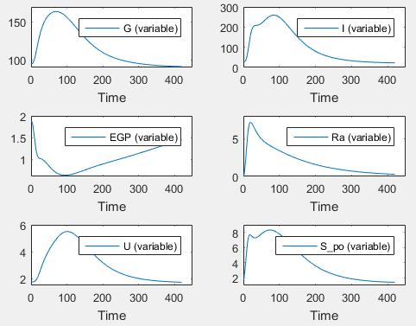
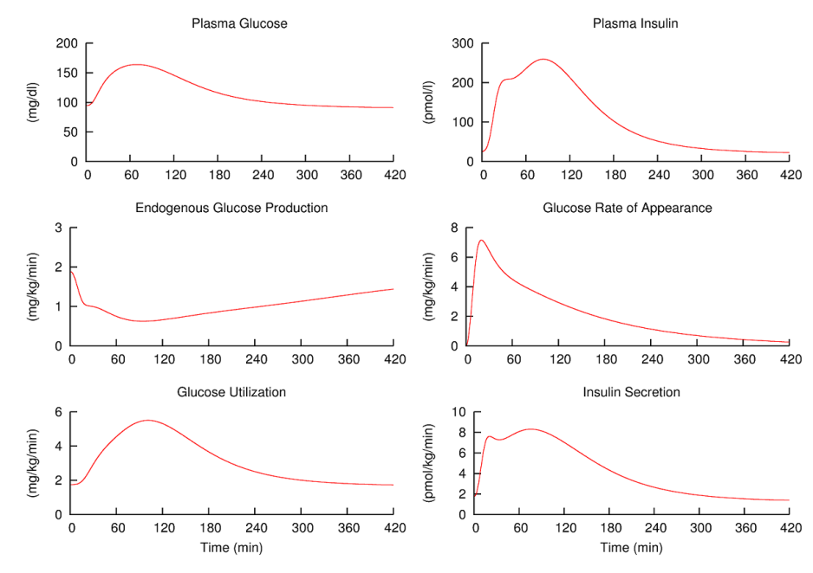
Some bad ... examples
The model reproduces the plots in the paper and on the biomodels.net webpage (http://www.ebi.ac.uk/biomodels-main/BIOMD0000000379)
So what is the problem?

Slide 48
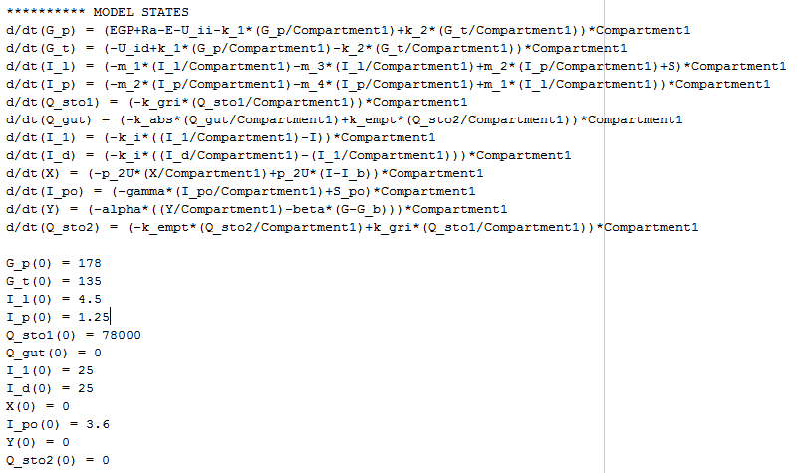
Some bad ... examples
The model is a „this particular simulation only“ model
No „Inputs“ to the model are
defined that would allow to
apply „glucose“ or „insulin“
doses
Specific time course of simulation
coded in initial conditions and
parameters
Potential for improvement:
  Code initial conditions such that model is in steady-state
  Use input definitions to allow application of glucose and/or insulin, etc.
  Document the model in the Notes section with respect to time units, meaning of model components ... What is Y?

Slide 49
Some bad ... examples
Lets load the second model and export it to an IQMmodel ODE representation
Lets simulate the model
Does it work? .... NO
The reason for not working is that the variables are not ordered correctly, for example, the variable „a“ is defined after it is used on the RHS for the variable „kempt“
  SBML does not enforce ordering, but many simulation tools do ... Including the parameter estimation tools NONMEM and MONOLIX
>> model = IQMmodel('Cobelli Glucose-Insulin System.xml', 1,1,1);
>> IQMcreateTEXTfile(model,'Cobelli');
>> edit Cobelli.txt
>> IQMsimulate(model,24*60)

Slide 50
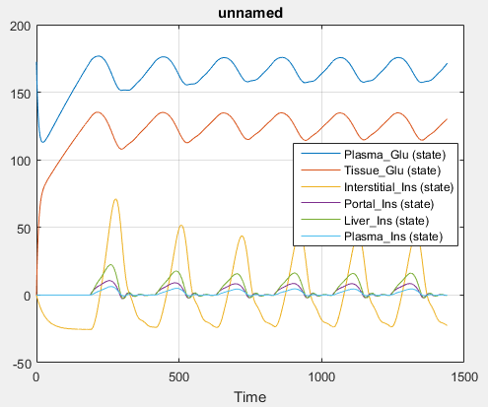
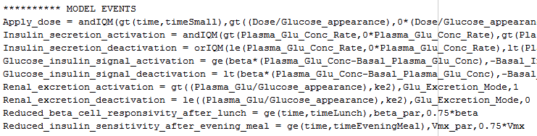
Some bad ... examples
Once the order of the variables has been manually
corrected (several iterations), the model can be
simulated
This model as well is a „this particular simulation only“
model, although some dose might be possible to apply
but the model lacks internal documentation to
understand what could be done or not
Another issue of the model wrt potential use in NLME parameter estimation scenarios is the presence of Events
  Neither NONMEM nor MONOLIX can handle events
  For this model here all events, except the Apply_dose
  event could have been coded with the SBML piecewise statement, which in NONMEM and MONOLIX can be translated to IF THEN ELSE statements

Slide 51
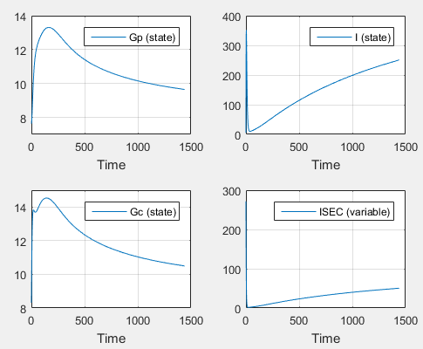
Some bad ... examples
Lets load the third model and export it to an IQMmodel ODE representation
Lets simulate the model
The model simulates fine
Whats the problem?
>> model = IQMmodel('MODEL1112110004_Silber2007', 0,0,1);
>> IQMcreateTEXTfile(model,'Silber');
>> edit Silber.txt
>> IQMsimulate(model,24*60)

Slide 52
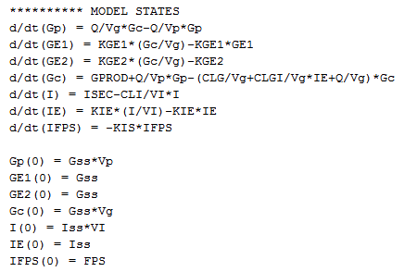
Some bad ... examples
It looks like the ODE for GE2 is wrong
  Missing „*GE2“
The model is not yet curated on
Biomodels.net, which might explain
the problem
The model again is a „this simulation only model“ - but the closest of the three examples to a useful one for later linking to NLME parameter estimation
Input definitions missing as well
The model code might have issues
*GE2

Slide 53
Suggestions for good modeling practice
To allow for using the model with NLME parameter estimation tools
Use state, parameter, variable and reaction names that somewhat explain what these components are
  For export to NONMEM these names should not be too long. MONOLIX can handle long names and anyway will be the better choice for systems pharmacology type of models, due to its far better numerical properties
  For export to NONMEM, do not define reactions in the IQMmodel. For MONOLIX this is possible
  Names of the parameters that you might want to consider for parameter estimation should not contain an underscore (‘_’)
Do not use Events in the model
  Often they can be avoided by using the piecewiseIQM statement, which does the same as the SBML piecewise function. For NONMEM and MONOLIX these are converted to IF THEN ELSE statements
Define initial conditions for the state variables to ensure the model is in steady-state
  Use non-numerical initial conditions to make them dependent on the parameterization of the model
  Choose them such that the model is in steady state if all external stimuli / inputs of interest are 0
Add well defined inputs to your model that allow to apply “external stimuli” to perform simulations of different scenarios. These inputs might later be defined from an NLME dataset for parameter estimation purposes
Document the purpose of your model in the Notes section, including time units, units of inputs and outputs

Slide 54
Tutorial Outline
General introduction to the IQM Tools Suite
Compliance mode
Models: dosing, output and parameter definitions
Dosing description and simulation
Import and export of SBML models
Important things to consider for systems pharmacology models
Interface to NLME Tools
  Conversion of IQMmodels to NONMEM and MONOLIX
  Running NONMEM and MONOLIX from IQM Tools
  Fitanalysis results – overview
  Robustness analysis
General representation of clinical data
Examples

Slide 55
Conversion of IQMmodels to NONMEM and MONOLIX
IQM Tools allows to easily generate MONOLIX and NONMEM code for parameter estimation
In the following several examples will be provided, based on
  Theophylline data
The goal in this tutorial is not to perform a complete model building, but to show how a model of interest can be converted to the parameter estimation tool of choice and perform the parameter estimation
  We limit ourselves to a PK model
  In later tutorials PKPD models, regression parameters, etc. will be covered

Slide 56
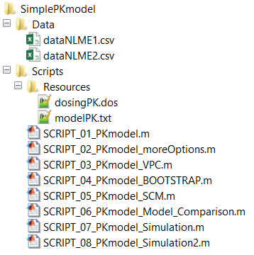
Theophylline Example
Change into Example Files/SimplePKmodel folder
Have a look at the
  two data files
  modelPK.txt file
  dosingPK.dos file
The two data files contain the same quantitative information, however the dataNLME1.csv file contains additional annotation that you might consider quite useful for the purpose of understanding of its contents
The modelPK.txt file contains the structural PK model that we want to convert to NONMEM and MONOLIX
The dosingPK.dos file contains information about the type of INPUT1 in the model

Slide 57
Required Dataset Columns (dataNLME2.csv)
Column Name | Meaning
IXGDF | Indices for records in the dataset. If dataset derived from a general dataset format each entry on IXGDF corresponds to the entry for IXGDF for this record in the general data format. If not derived, column still required.
ID | Unique numeric subject ID, used by NONMEM and MONOLIX
USUBJID | Unique subject ID, used in the clinical database
TIME | Time of event in a row with 0 determining time of first dose
TIMEPOS | Time of event in a row with 0 the time of the first event (needed for NONMEM, since crashing for negative times)
NT | Nominal time of the event (per protocol). Useful for binning
YTYPE | 0 for dose events, otherwise containing the number of the model OUTPUT with which this observation should be compared
DV | Observed value of this observation
CENS | If 1 then observation assumed to be below lower limit of quantification. DV then needs to contain the LLOQ. Otherwise CENS=0
MDV | =1 for doses, =0 for observations, =1 for „missing observations“ or observations that should not be considered for parameter estimation
EVID | =1 for doses, =0 for observations
AMT | =0 for observations, =value of dose for dosing events
ADM | =0 for observations, otherwise containing the number of the model INPUT to which this dose is to be applied
RATE | Rate of dose, 0 for bolus, AMT/infusion time for infusion, etc.

Slide 58
Useful Dataset Columns (dataNLME1.csv)
Column Name | Meaning
NAME | Name of the event in a row. Unique per YTYPE. Gives information about the actual readout. YTYPE=1 does not say much. NAME = „Theophylline Concentration“ is more informative. Will be used by IQM Tools, e.g., for annotation of simulations, VPCs, etc. The reason for „:::“ in the NAME column is that NONMEM is unable to deal with spaces in text. IQM Tools will replace „:::“ by spaces for display purposes
UNIT | Unit of the observation or dose in a row. Will be used by IQM Tools, e.g., for annotation of simulations, VPCs, etc.
TIMEUNIT | Unit of all time related information in the dataset (including RATE). Will be used by IQM Tools, e.g., for annotation of simulations, VPCs, etc.
TRTNAME | Treatment group name. In the Theopylline Example only a single treatment group is present, but still, it is informative. Will be used by IQM Tools, e.g., for annotation of stratified VPCs
TRT | Numeric equivalent to TRTNAME, can be used as a covariate.
ROUTE | Information about the route of administration
These additional columns make the dataset more complete and self explaining
In Part 5 of the tutorials we will learn about the general dataset format that is used by IQM Tools, which contains even more additional and very useful columns
It is sad but true that most data files in the pharmacometric world look like dataNLME2.csv

Slide 59
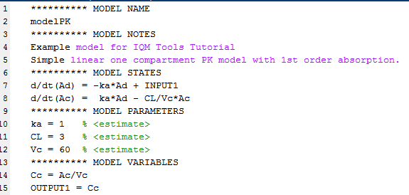
The Model
The modelPK.txt file is a standard IQMmodel, containing
  INPUT1 (to be linked to doses in data with ADM=1)
  OUTPUT1 (to be linked to observation records with YTYPE=1)
  3 parameters to be estimated (<estimate>)

Slide 60
Theophylline Example
Change into Example Files/SimplePKmodel/Scripts folder
Open SCRIPT_01_PKmodel.m in the MATLAB editor
  This script follows the „Compliance Guideline“ of IQM Tools
    Clean MATLAB workspace, path, etc
    Install IQM Tools
    Setup Compliance Mode
Please update line number 12 with the path of your IQM Tools installation:
Execute lines 4-16 in the script (highlight them and press „F9“)

Slide 61
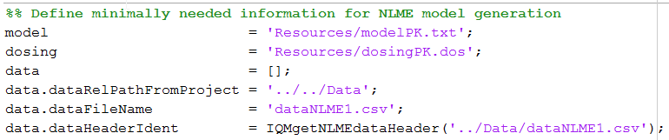
Theophylline Example
The following code in SCRIPT_01_PKmodel.txt defines the minimally needed information for model conversion to MONOLIX and NONMEM
Execute the code above
model | Relative path from the Scripts folder to the IQMmodel text file that should be used for conversion.
dosing | We need to define which INPUT type is desired. In the model only a single input INPUT1 is defined. Underlying assumption: INPUT1 is a bolus into the dosing compartment. Thus „dosing“ needs to have as first and only type „BOLUS“.
data | This is a MATLAB structure which contains 3 different fields related to the dataset location and its structure.
data.dataRelPathFromProject | Defined the relative path from the desired project folder location to the dataset. We plan to create the NLME project in ../Models/“projectname“.
data.dataFileName | Name of the dataset to be used (without path).
data.dataHeaderIdent | Cell-array with identifiers, defining the meaning of the columns in the dataset.

Slide 62
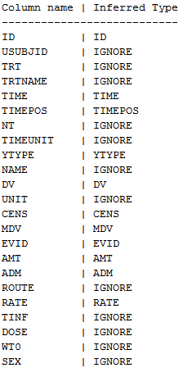
data.dataHeaderIdent
In this example:
data.dataHeaderIdent = {ID,IGNORE,IGNORE,IGNORE,TIME,TIMEPOS,IGNORE,IGNORE,YTYPE,IGNORE,DV,IGNORE,CENS,MDV,EVID, AMT,ADM,IGNORE,RATE,IGNORE,IGNORE,IGNORE,IGNORE}
MONOLIX users will understand what it means
If you are a NONMEM user, then please have a look in the
MONOLIX manual
The good thing is that the function IQMgetNLMEdataHeader
generates this header automatically and correctly
>> help IQMgetNLMEdataHeader

Slide 63
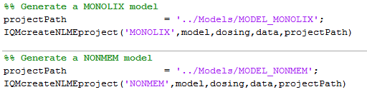
MONOLIX and NONMEM Model Creation
The function IQMcreateNLMEproject creates NONMEM or MONOLIX models
Additionally to the previously defined information the „projectPath“ needs to be defined. This is the path to the folder in which to create the NLME model
Execute the code above

Slide 64
MONOLIX and NONMEM Model Creation
Change into Example Files/SimplePKmodel/Models folder
Have a look at the generated NONMEM and MONOLIX code
Default settings for IQMcreateNLMEproject
  NONMEM: SAEM
  Lognormal distribution for individual parameters
  Additive error model
  Diagonal covariance matrix
  Etc.
IQMcreateNLMEproject has many optional argument, allowing to control most NLME features of interest
>> help IQMcreateNLMEproject

Slide 65
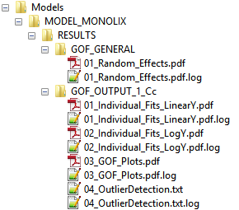
Running NONMEM and MONOLIX Models
Change into Example Files/SimplePKmodel/Scripts folder
An NLME model can be run by the following command
Change into Example Files/SimplePKmodel/Models folder
Have a look at the content in the RESULTS folders
for both models
  The subfolders in the RESULTS folders contain a wide range
  of goodness of fit assessments for the models – no need to
  postprocess the output of NONMEM and MONOLIX manually
>> help IQMrunNLMEproject % Get help
>> IQMrunNLMEproject('../Models/MODEL_MONOLIX') % Run the MONOLIX model
>> IQMrunNLMEproject('../Models/MODEL_NONMEM') % Run the NONMEM model

Slide 66
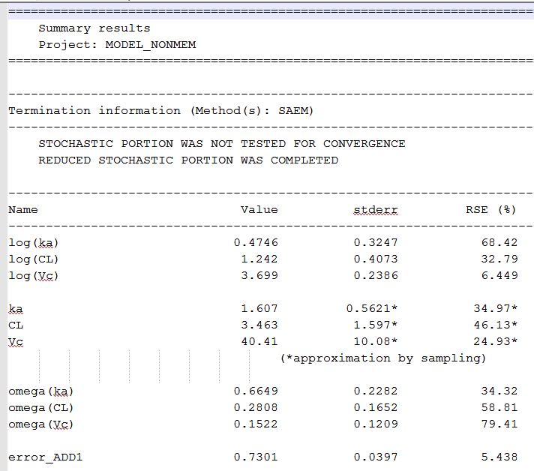
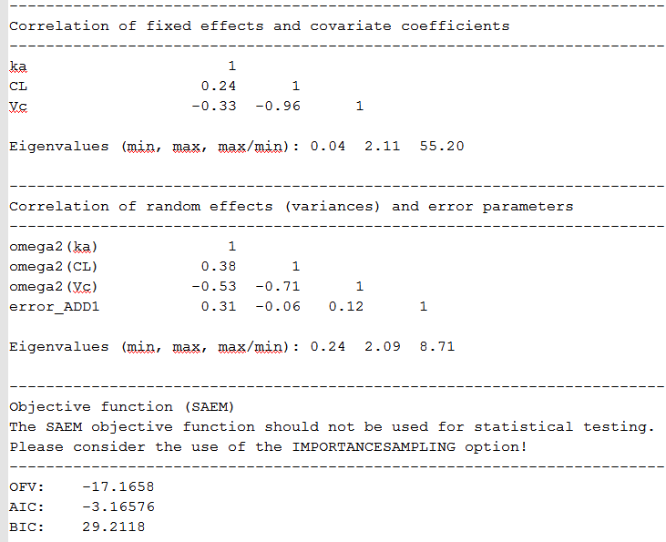
Results on NONMEM and MONOLIX runs
Have a look at the project_results.txt file in the MODEL_NONMEM/RESULTS folder
Compared to the typical NONMEM log file this one is very readable and informative

Slide 67
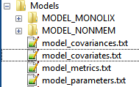
Running all NLME Models in a Folder
If NLME models/projects are located within the same top folder (here: „Models“), they can be run in parallel by the following command:
  Parallel runs only possible if the parallel toolbox for MATLAB available, otherwise these models will be run sequentially
  Parallel runs also require correct setup of IQMpro/SETUP_PATHS_TOOLS_IQMPRO.m
Using IQMrunNLMEprojectFolder will generate additional information in the folder in which the NLME projects are located – have a look at “../Models” – it now contains four additional files (and their 4 log files)
  model_metrics.txt, model_parameters.txt,
  model_covariates.txt, model_covariances.txt
  Have a look at these files – self explaining and we will see more
  in the tutorials
>> help IQMrunNLMEprojectFolder % Get help
>> IQMrunNLMEprojectFolder('../Models') % Run all NLME models in folder

Slide 68
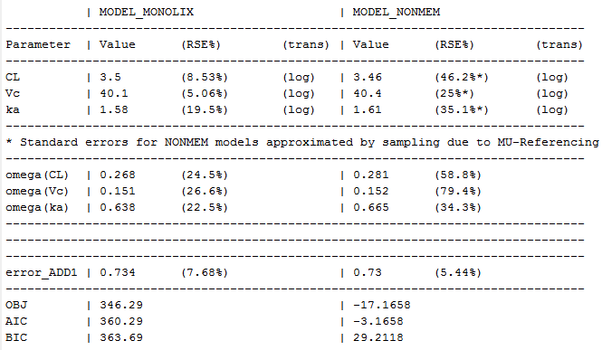
Creation of Model Result Tables
Execute the following code in the script
This produces the following table, which with the reporting package of IQM Tools can be directly included into Word, LaTeX and HTML reports
See the „../Output“ folder for the generated table text file and the associated log file

Slide 69
Defining more Options for NLME Model Generation
The function IQMcreateNLMEproject has many optional settings, which might require quite some text for their definition. It is still far easier than to write MONOLIX or NONMEM code, but it takes time
IQM Tools contains a function that generates template code with almost all features, allowing the user to do quick modifications and be done
Preparation for tutorial example
  Change into Example Files/SimplePKmodel/Scripts folder
  Open SCRIPT_02_PKmodel_moreOptions.m in the MATLAB editor
  Update line number 12 with the path of your IQM Tools installation
  Execute lines 4-16 in the script (highlight them and press „F9“)
>> help IQMcreateNLMEmodelGENcode

Slide 70
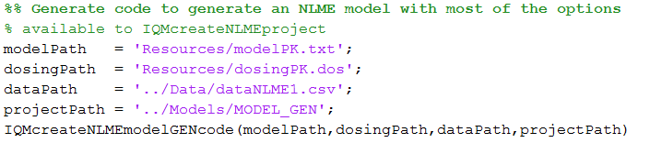
Defining more Options for NLME Model Generation
Execute the following code in the SCRIPT_02_PKmodel_moreOptions.m
  This command generates template text in a temporary file and opens it in the MATLAB editor
  Copy the generated code into the SCRIPT_02_PKmodel_moreOptions.m, starting from line 27
  Read through the generated code – it is very well documented in should be almost self explaining

Slide 71
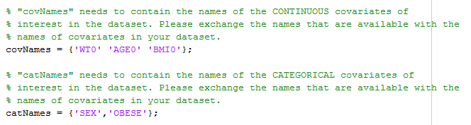
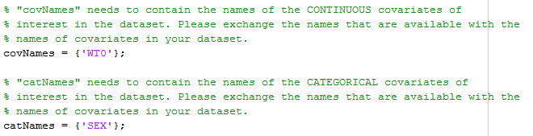
Defining more Options for NLME Model Generation
Locate the following lines in the generated code
Edit to match the following (we need to define the candidate covariates that are present in the dataset and which we might want to consider in the model)

Slide 72



Defining more Options for NLME Model Generation
Execute the first cell, defining the algorithm settings
Execute the second cell, defining the candidate covariates
In the third cell, please locate the following code
and update to match the following
This will estimate covariate coefficients for WT0 on CL and Vc, and SEX on CL.
In the third cell towards the bottom, please comment out either the NONMEM or the MONOLIX model generation
Execute the third cell, generating the NLME model and running it

Slide 73
Defining more Options for NLME Model Generation
Have a look at the output for the generated model in ../Models/MODEL_GEN
If you want, repeat the exercise with NONMEM instead of MONOLIX or vice versa
Interesting:
  The same NLME dataset is used for both tools
  Switching tools is not more complicated than switching „NONMEM“ for „MONOLIX“ or the other way round

Slide 74
A word about implementation of covariates
Previous example showed the use of WT0 and SEX as covariates, but not how these covariates are mathematically implemented in the NONMEM or MONOLIX model
IQM Tools handles covariates in the following way:
  MU-referencing when exporting to NONMEM (In MONOLIX this is implicitly done)
  Centers continuous covariates automatically by the median of the covariate in the dataset
  Log-transforms the centered continuous
  Numerically smallest category of a categorical covariate is used as references value
  Additive aggregation of covariate terms and MU in the transformed parameter domain (according to the chosen distribution of the individual parameters)
  Example continuous covariate (with assumed median of 70):
  Example categorical covariate (SEX=1 male, =2 female)
log(CL) = log(TCL) + beta*log(WT0/70)
=> CL = TCL*(WT0/70)^beta
log(CL_male) = log(TCL)
log(CL_female) = log(TCL) + beta

Slide 75
A word about implementation of covariates
This means that the implementation of the covariates is slightly different from what Pharmacometricians are used to
However, the following needs to be considered:
  For the typical applications in the Pharma industry such an approach is enough to identify covariates of clinical relevance and thus viable and acceptable
  For research applications where the goal is to assess many different possible covariate models and compare them to each other, IQM Tools still allows to code the mathematical expressions of the covariate models into the IQMmodels code.
    In this case, the following needs to be considered:
      Covariates need to be passed to the model as regression parameters
      The SAEM algorithm should not be used. Please used gradient based methods from NONMEM in this case
Any covariate expression is possible in IQM Tools, if defining models manually
For automatic tools, such as SCM, the standard approach is used
CL = TCL*(AGE0-40)^beta1*(1+beta2*(SEX-1))

Slide 76
Robustness Analysis of NLME Parameter Estimations
In order to assess the robutsness of parameter estimates it is possible to consider the standard errors of the estimated parameters
However, this often does not give the full picture and often is overly optimistic
IQM Tools allows to easily run the same model N times from randomized initial guesses
This allows to assess the robustness of the parameter estimates and thus the robustness of the model in detail
  Not robust models often are identified by a large difference in final objective function values and in correlations of parameter values with each other
In the following we will perform such a robustness analysis

Slide 77



Robustness Analysis of NLME Parameter Estimations
Locate the following lines in the code
Exchange against (since WT0 and SEX were not significant on CL)
Locate the following lines in the code
Setup the robustness analysis by exchanging with
Execute the 3rd cell to generate the 10 models

Slide 78
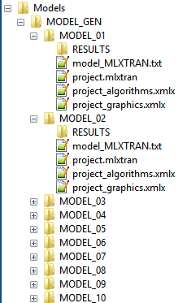


Robustness Analysis of NLME Parameter Estimations
Have a look into Models/MODEL_GEN
  10 Models have been generated
  Only difference: randomly sampled initial guesses for the
  fixed effect parameters that are estimated
Execution of the third cell lead to an error when
attempting to run the models with the command
Here there are several models generated in
„projectPath“ and thus the above command needs to be
exchanged to
Re-run the third cell to generate and run the 10 models

Slide 79
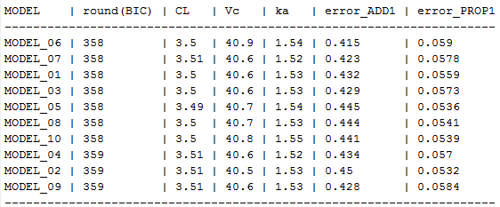
Robustness Analysis of NLME Parameter Estimations
Please have a look at the folder Models/MODEL_GEN and the contained text files
These give a good overview of the robustness of this model
Note: the purpose of this robustness functionality is not to try to find some initial guesses that might make a numerically unstable NLME Tool of choice to converge to a solution, as PsN Execute does. The goal of this function is to generate valuable information about a models robustness to allow the modeler to take decisions with respect to which parameters (fixed and/or random) to estimate and which not.

Slide 80
Tutorial Outline
General introduction to the IQM Tools Suite
Compliance mode
Models: dosing, output and parameter definitions
Dosing description and simulation
Import and export of SBML models
Important things to consider for systems pharmacology models
Interface to NLME Tools
General representation of clinical data
  Generalized data format for clinical data used in IQM Tools
  Checking of data consistency
  Conversion to task specific dataset format
  Graphical exploration
  Conversion to dataset for nonlinear mixed effect parameter estimation
Examples

Slide 81
General standard dataset
Capturing clinically relevant information
Reuse of the data for many purposes (across line functions – DMPK, PMX, STATS)
Collection of data in databases
Efficient data preparation
Efficient data checking => higher quality data
Efficient standard analyses
Easy integration in workflow approaches

Slide 82

General standard dataset – is it feasible?
It is not only feasible – it is absolutely necessary!

Slide 83
Documentation of General Standard Dataset used in IQM Tools
Column Name | Type | Description
IXGDF | numeric | Column containing numeric indices for each record (1,2,3,4,5, ...) to allow for matching records in case of post-processing the general dataset format
IGNORE | string | Reason/comment related to exclusion of the sample/observation from the analysis
USUBJID | string | Unique subject identifier
COMPOUND | string | Name of the investigational compound
STUDY | string | Study number
STUDYDES | string | Study description
PART | string | Part of study as defined per protocol (1 if only one part)
EXTENS | numeric | Extension of the core study (0 if not extension, 1 if extension)
CENTER | numeric | Center number
SUBJECT | string | Subject identifier (within a center - typically not unique across whole dataset)
INDNAME | string | Indication name
TRTNAME | string | Name of actual treatment given
TRTNAMER | string | Name of treatment to which individual was randomized
VISIT | numeric | Visit number
VISNAME | string | Visit name
BASE | numeric | Flag indicating assessments at baseline (=0 for non-baseline, =1 for first baseline, =2 for second baseline, etc.)
SCREEN | numeric | Flag indicating assessments at screening (=0 for non-screening, =1 for first screening, =2 for second screening, etc.)

Slide 84
Documentation of General Standard Dataset used in IQM Tools
Column Name | Type | Description
DATEDAY | String | Start date of event ('01-JUL-2015')
DATETIME | string | Start time of event ('09:34')
DURATION | numeric | Duration of event in same time units as TIMEUNIT
NT | numeric | Planned time of event. Based on protocol, in the time unit defined in TIMEUNIT column
TIME | numeric | Actual time of event relative to first administration, in the time unit defined in TIMEUNIT column
TIMEUNIT | string | Unit of all numerical time definitions in the dataset ('hours','days','weeks','minutes')
TYPENAME | string | Unique type of event
NAME | string | Unique name for the event
VALUE | numeric | Value of the event, defined by NAME. E.g., the given dose, the observed PK concentration, or the value of other readouts. The values need to be in the units, defined in the UNIT column. Specific cases: For concomitant medications the dose will be given For BLOQ values, 0 will be used Severity levels for adverse events Should not be populated if VALUE_TEXT is populated
VALUETXT | string | Text version of value (if available and useful). Character value as given in the CRF. Should not be populated if VALUE is populated

Slide 85
Documentation of General Standard Dataset used in IQM Tools
Column Name | Type | Description
UNIT | string | Unit of the value reported in the VALUE column. For same event the same unit has to be used across the dataset.
ULOQ | numeric | Upper limit of quantification of event defined by NAME
LLOQ | numeric | Lower limit of quantification of event defined by NAME
ROUTE | string | Route of administration (iv, subcut, intramuscular, intraarticular, oral, inhaled, topical, rectal)
INTERVAL | numeric | Interval of dosing, if single row should define multiple dosings
NRDOSES | numeric | Number of doses given with the specified interval, if single row should define multiple dosings
COMMENT | string | Additional information for the observation/event
The general dataset format in IQM Tools covers >95% of the typical pharmacometric analyses. It is certainly not complete and perfect, but it is a start in the right direction. An industry wide agreement would be of tremendous interest.

Slide 86
Documentation of General Standard Dataset used in IQM Tools
Optional columns in the IQM Tools General Standard Dataset format
  The general data format might also contain the following columns, which are numeric equivalents to some string columns. If not provided, then these are generated automatically in the post processing steps of the general dataset in IQM Tools
Column Name | Type | Description
IND | numeric | Numeric indication flag (unique for each entry in INDNAME)
STUDYN | numeric | Numeric study flag (unique for each entry in STUDY)
TRT | numeric | Numeric actual treatment flag (unique for each entry in TRTNAME)
TRTR | numeric | Numeric randomized treatment flag (unique for each entry in TRTNAMER)

Slide 87
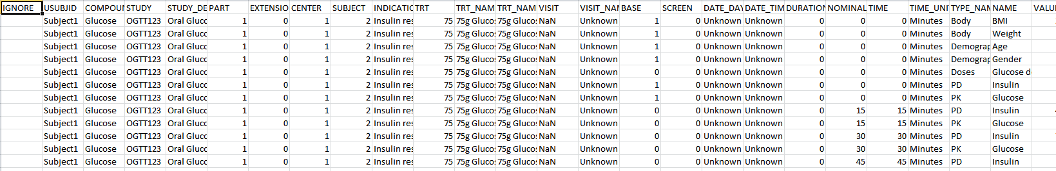
Example for a General Standard Dataset
Please change into the Example Files/SimpleSysPharmExample/Data folder
Open the data_general.csv file
Have a look

Slide 88
General standard dataset
Processing and Exploration
Please change into the Example Files/SimpleSysPharmExample/Scripts folder
Open the SCRIPT_01_prepare_explore_data.m file in the MATLAB editor
    Update line 14 with the path to your installation of IQM Tools
It will walk you through the following steps:
  Checking of data consistency
  Conversion to task specific dataset format
  Graphical exploration
  Conversion to dataset for nonlinear mixed effect parameter estimation
IQM Tools contains a large number of analysis function. In this example a wrapper function has been called that performs a large range of analyses. The user can do own analyses as well or use smaller sub functions in IQM Tools.
Functions in IQM Tools are documented here:
>> doc IQMlite
>> doc IQMpro

Slide 89
Tutorial Outline
General introduction to the IQM Tools Suite
Compliance mode
Models: dosing, output and parameter definitions
Dosing description and simulation
Import and export of SBML models
Important things to consider for systems pharmacology models
Interface to NLME Tools
General representation of clinical data
Examples

Slide 90
Simple Glucose-Insulin Interaction Example
The data that has been explored in the previous section is the basis for NLME parameter estimation
Please change into the folder Example Files/SimpleSysPharmExample/Scripts
Open the file SCRIPT_02_model.m
  Update line 14 with the path to your installation of IQM Tools
Please work through the example script by executing the different parts and having a look at the output of these parts in the folder „Models“
In a classroom setting we will go through all of this in more detail

Slide 91
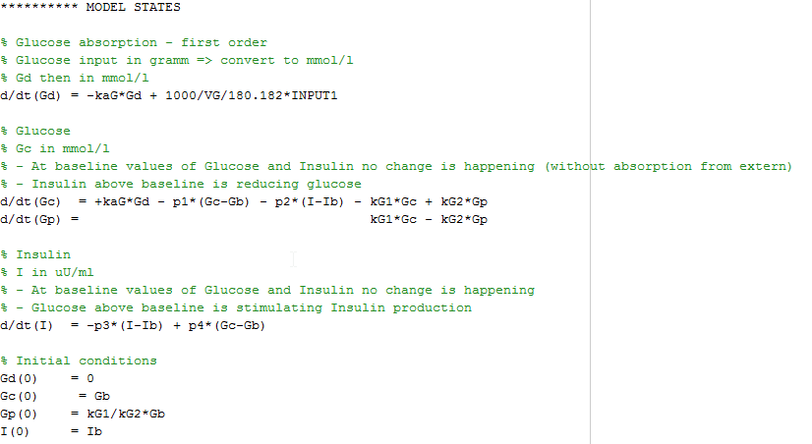
Simple Glucose-Insulin Interaction Example
Simplistic Model
Ensuring that the model is in steady-state for no external input

Slide 92
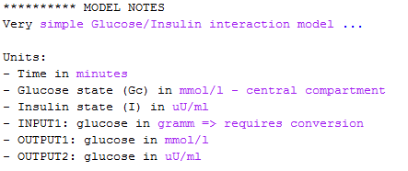
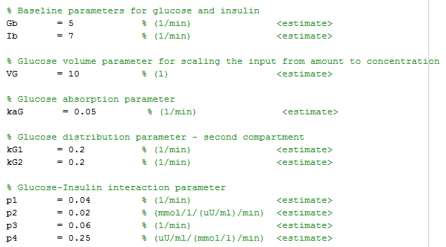
Simple Glucose-Insulin Interaction Example
Simplistic Model
Units and input/outputs are documented
Parameters are documented

Slide 93
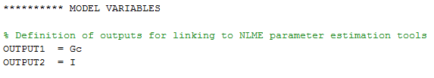
Simple Glucose-Insulin Interaction Example
Simplistic Model
Outputs of the model are defined
  OUTPUT1 will be linked to the readout in the NLME dataset with YTYPE = 1
  OUTPUT2 will be linked to the readout in the NLME dataset with YTYPE = 2
If your model has more outputs that have matches with the observed data ... There is no limit ...

Slide 94
Simple Glucose-Insulin Interaction Example
Simplistic Model
The model contains a single input definition (INPUT1), which defines a glucose bolus, taken orally. The unit of the administered glucose is gramm
The dataset contains glucose doses (ADM=1, linking to INPUT1)
Drug action could be added into the model by adding a PK model part and concentration dependent modulation of model properties of interest
  This PK model part would get an INPUT2
  For parameter estimation with drug action, the dataset would also need to contain drug dosing information with ADM=2, linking to INPUT2
For now, the model is simplistic, but nothing prevents you to make the model as complex as you wish – as long you implement drug and other external inputs in the right way
Currently it is an extreme lack of time that leads to this simple and not a more elaborate example ...

Slide 95
Selection of parameters to be estimated
Assuming you have 100s of parameters in your model and you want to know which ones to estimate ... Good luck ;-)
Still, something can be done
  If you have a larger model with many parameters you most likely have already parameterized it as good as you were able to (literature data, manual tuning to reference profiles, ...)
  The model most likely already describes semi-quantitatively the behavior of interest and you just want to get more out of the model (e.g. covariates, drug action, etc.)
  In this case you could think about using local sensitivity analysis
    Perform a parametric sensitivity analysis around a trajectory or input/dosing setting of interest and check how much impact the different parameters have on your readouts of interest (which are also the ones you expect to have in the dataset for parameter estimation)
    Look at correlations of sensitivity trajectories, etc., etc.
    Optimal design methods (just the evaluation step), calculating the Fisher Information Matrix are of interest as well ... And still on the todo list for implementation into IQM Tools
Then select a first set of parameters for estimation and give it a try ...

Slide 96
Simple Glucose-Insulin Interaction Example
The data that has been explored in the previous section is the basis for NLME parameter estimation
Please change into the folder Example Files/SimpleSysPharmExample/Scripts
Open the file SCRIPT_02_model.m
  Update line 14 with the path to your installation of IQM Tools
Please work through the example script by executing the different parts and having a look at the output of these parts in the folder „Models“
In a classroom setting we will go through all of this in more detail

Slide 97
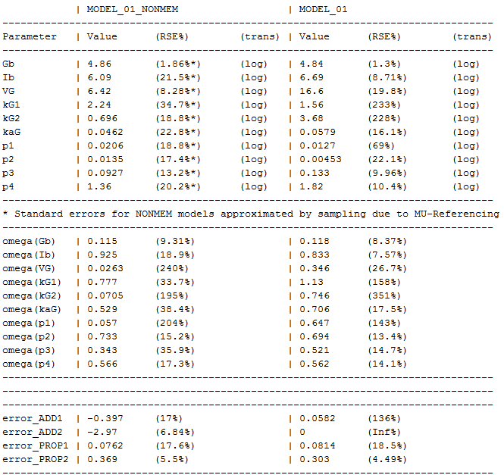
Discussion of results for MODEL_01
Parameters for MODEL_01 where estimated with both NONMEM and MONOLIX
Results are quite different for some of the parameters
Which parameter estimation tool got it more correct?

Slide 98
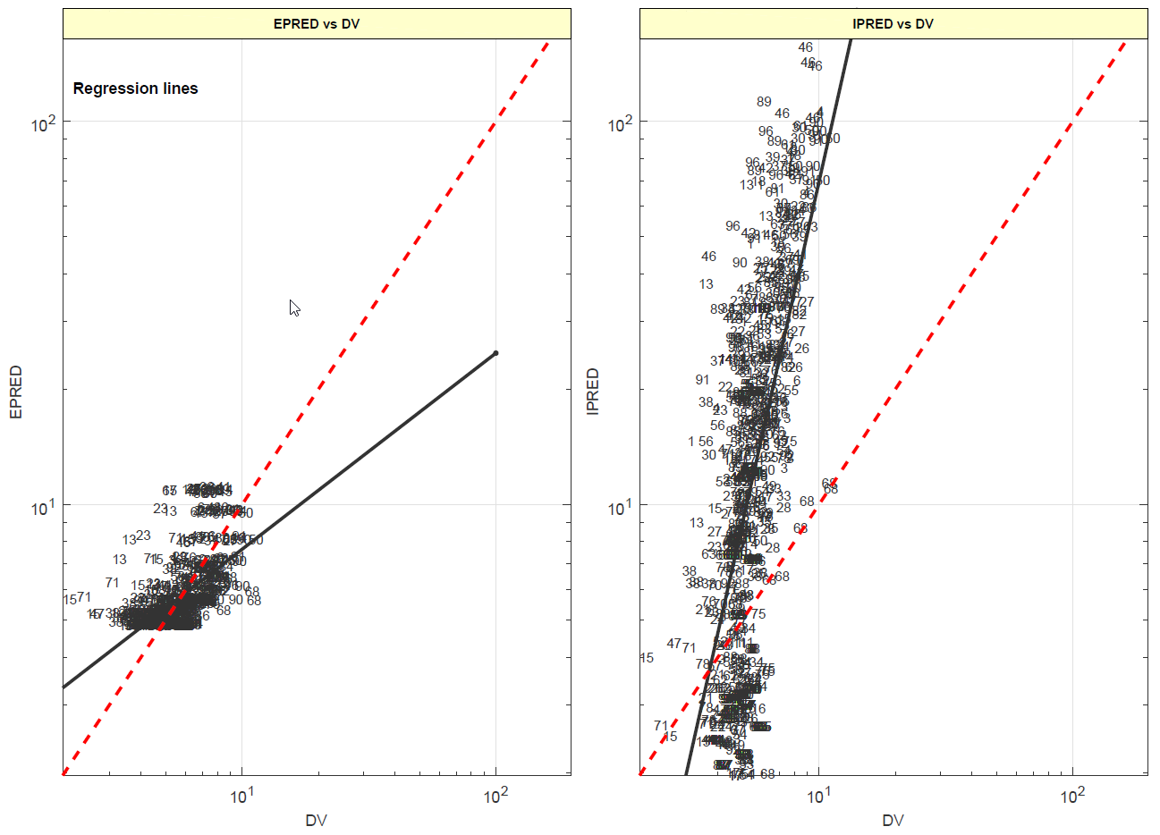
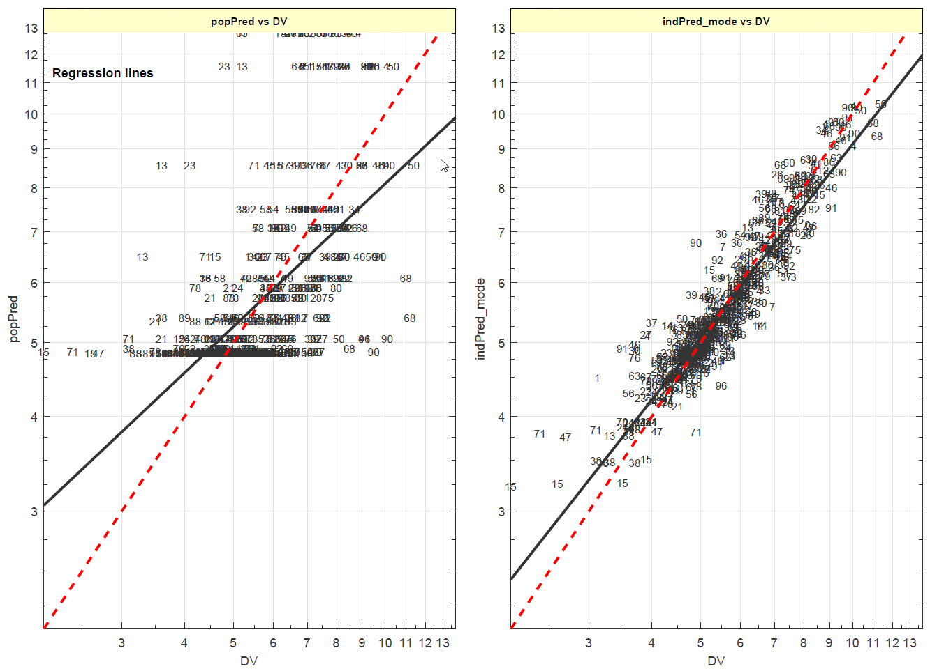
Some Goodness-of-fit Results for MODEL_01
NONMEM
Reason for bad results is most likely
over-parameterization (see RSEs in MONOLIX results)
MONOLIX

Slide 99
Tutorial Goal: „You should now be able to“
Understand and use the compliance mode – or switch it off
Define IQMmodels with dosing inputs and simulate dosing scenarios
Import models from SBML to IQMmodels, add inputs and outputs for simulation and NLME approaches
Understand the requirements on model definition for use of NONMEM or MONOLIX as parameter estimation tools
Convert models to NONMEM and MONOLIX and estimate parameters
Understand and handle the general dataset specification

Slide 100
THE END
Thank you for your participation and interest!

